Slide 1
Computing with a Thesaurus
Word Senses and Word Relations

Slide 2
Terminology: lemma and wordform
A lemma or citation form
Same stem, part of speech, rough semantics
A wordform
The inflected word as it appears in text
Wordform | Lemma
banks | bank
sung | sing
duermes | dormir

Slide 3
Lemmas have senses
One lemma “bank” can have many meanings:
…a bank can hold the investments in a custodial account…
“…as agriculture burgeons on the east bank the river will shrink even more”
Sense (or word sense)
A discrete representation
of an aspect of a word’s meaning.
The lemma bank here has two senses
Sense 1:
1
Sense 2:
2

Slide 4
Homonymy
Homonyms: words that share a form but have unrelated, distinct meanings:
bank₁: financial institution, bank₂: sloping land
bat₁: club for hitting a ball, bat₂: nocturnal flying mammal
Homographs (bank/bank, bat/bat)
Homophones:
Write and right
Piece and peace

Slide 5
Homonymy causes problems for NLP applications
Information retrieval
“bat care”
Machine Translation
bat: murciélago (animal) or bate (for baseball)
Text-to-Speech
bass (stringed instrument) vs. bass (fish)

Slide 6
Polysemy
1. The bank was constructed in 1875 out of local red brick.
2. I withdrew the money from the bank
Are those the same sense?
Sense 2: “A financial institution”
Sense 1: “The building belonging to a financial institution”
A polysemous word has related meanings
Most non-rare words have multiple meanings

Slide 7
Metonymy or Systematic Polysemy: A systematic relationship between senses
Lots of types of polysemy are systematic
School, university, hospital
All can mean the institution or the building.
A systematic relationship:
Building Organization
Other such kinds of systematic polysemy:
Author (Jane Austen wrote Emma)
Works of Author (I love Jane Austen)
Tree (Plums have beautiful blossoms)
Fruit (I ate a preserved plum)

Slide 8
How do we know when a word has more than one sense?
The “zeugma” test: Two senses of serve?
Which flights serve breakfast?
Does Lufthansa serve Philadelphia?
?Does Lufthansa serve breakfast and San Jose?
Since this conjunction sounds weird,
we say that these are two different senses of “serve”

Slide 9
Synonyms
Word that have the same meaning in some or all contexts.
filbert / hazelnut
couch / sofa
big / large
automobile / car
vomit / throw up
Water / H₂0
Two lexemes are synonyms
if they can be substituted for each other in all situations
If so they have the same propositional meaning

Slide 10
Synonyms
But there are few (or no) examples of perfect synonymy.
Even if many aspects of meaning are identical
Still may not preserve the acceptability based on notions of politeness, slang, register, genre, etc.
Example:
Water/H₂0
Big/large
Brave/courageous

Slide 11
Synonymy is a relation between senses rather than words
Consider the words big and large
Are they synonyms?
How big is that plane?
Would I be flying on a large or small plane?
How about here:
Miss Nelson became a kind of big sister to Benjamin.
?Miss Nelson became a kind of large sister to Benjamin.
Why?
big has a sense that means being older, or grown up
large lacks this sense

Slide 12
Antonyms
Senses that are opposites with respect to one feature of meaning
Otherwise, they are very similar!
dark/light short/long fast/slow rise/fall
hot/cold up/down in/out
More formally: antonyms can
define a binary opposition
or be at opposite ends of a scale
long/short, fast/slow
Be reversives:
rise/fall, up/down

Slide 13
Hyponymy and Hypernymy
One sense is a hyponym of another if the first sense is more specific, denoting a subclass of the other
car is a hyponym of vehicle
mango is a hyponym of fruit
Conversely hypernym/superordinate (“hyper is super”)
vehicle is a hypernym of car
fruit is a hypernym of mango
Superordinate/hyper | vehicle | fruit | furniture
Subordinate/hyponym | car | mango | chair

Slide 14
Hyponymy more formally
Extensional:
The class denoted by the superordinate extensionally includes the class denoted by the hyponym
Entailment:
A sense A is a hyponym of sense B if being an A entails being a B
Hyponymy is usually transitive
(A hypo B and B hypo C entails A hypo C)
Another name: the IS-A hierarchy
A IS-A B (or A ISA B)
B subsumes A

Slide 15
Hyponyms and Instances
WordNet has both classes and instances.
An instance is an individual, a proper noun that is a unique entity
San Francisco is an instance of city
But city is a class
city is a hyponym of municipality...location...

Slide 16
Meronymy
The part-whole relation
A leg is part of a chair; a wheel is part of a car.
Wheel is a meronym of car, and car is a holonym of wheel.

Slide 17
Computing with a Thesaurus
Word Senses and Word Relations

Slide 18
Computing with a Thesaurus
WordNet

Slide 19
WordNet 3.0
A hierarchically organized lexical database
On-line thesaurus + aspects of a dictionary
Some other languages available or under development
(Arabic, Finnish, German, Portuguese…)
Category | Unique Strings
Noun | 117,798
Verb | 11,529
Adjective | 22,479
Adverb | 4,481

Slide 20
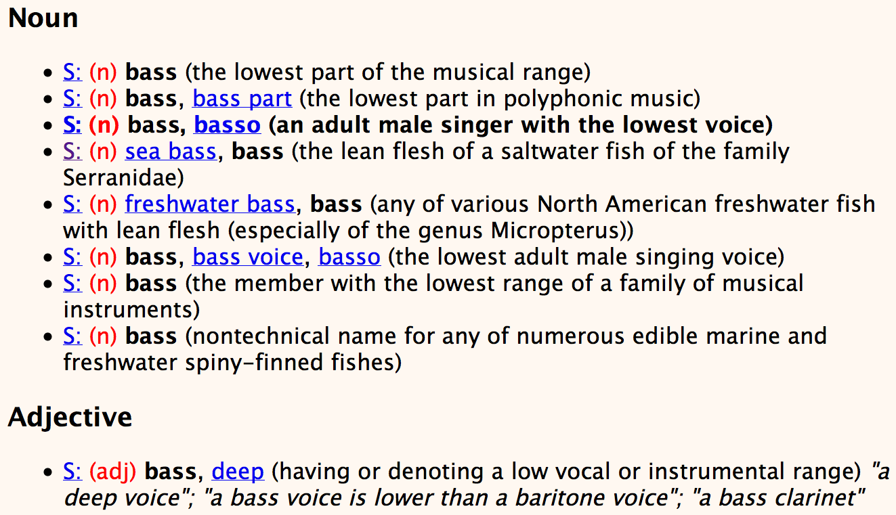
Senses of “bass” in Wordnet

Slide 21
How is “sense” defined in WordNet?
The synset (synonym set), the set of near-synonyms, instantiates a sense or concept, with a gloss
Example: chump as a noun with the gloss:
“a person who is gullible and easy to take advantage of”
This sense of “chump” is shared by 9 words:
chump¹, fool², gull¹, mark⁹, patsy¹, fall guy¹, sucker¹, soft touch¹, mug²
Each of these senses have this same gloss
(Not every sense; sense 2 of gull is the aquatic bird)

Slide 22
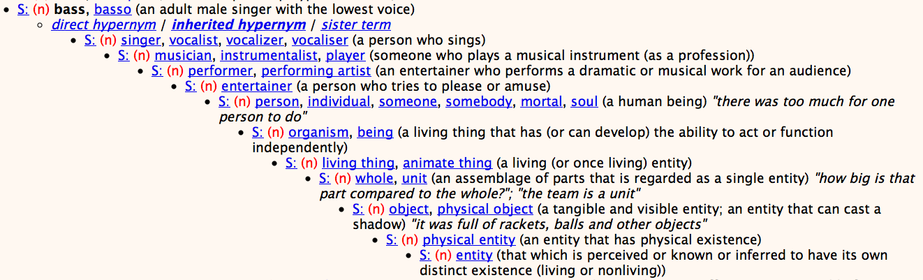
WordNet Hypernym Hierarchy for “bass”

Slide 23
WordNet Noun Relations

Slide 24
WordNet VerbRelations

Slide 25
WordNet: Viewed as a graph

Slide 26
“Supersenses” The top level hypernyms in the hierarchy
(counts from Schneider and Smith 2013’s Streusel corpus)

Slide 27
Supersenses
A word’s supersense can be a useful coarse-grained representation of word meaning for NLP tasks

Slide 28
WordNet 3.0
Where it is:
http://wordnetweb.princeton.edu/perl/webwn
Libraries
Python: WordNet from NLTK
http://www.nltk.org/Home
Java:
JWNL, extJWNL on sourceforge

Slide 29
Other (domain specific) thesauri

Slide 30
MeSH: Medical Subject Headings thesaurus from the National Library of Medicine
MeSH (Medical Subject Headings)
177,000 entry terms that correspond to 26,142 biomedical “headings”
Hemoglobins
Entry Terms: Eryhem, Ferrous Hemoglobin, Hemoglobin
Definition: The oxygen-carrying proteins of ERYTHROCYTES. They are found in all vertebrates and some invertebrates. The number of globin subunits in the hemoglobin quaternary structure differs between species. Structures range from monomeric to a variety of multimeric arrangements
Synset

Slide 31
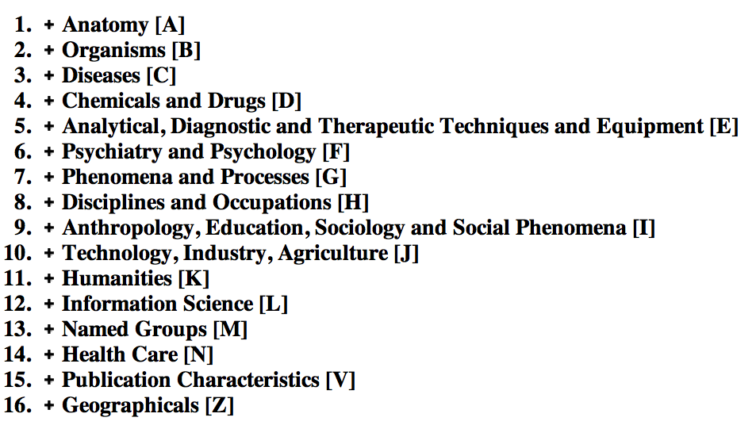
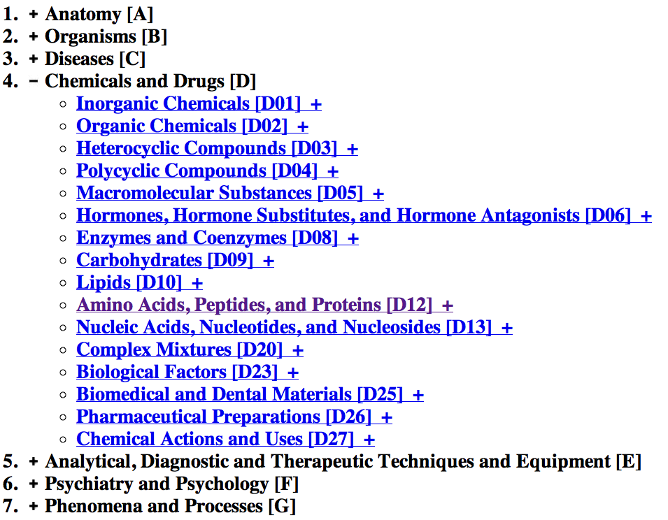
The MeSH Hierarchy
a

Slide 32
Uses of the MeSH Ontology
Provide synonyms (“entry terms”)
E.g., glucose and dextrose
Provide hypernyms (from the hierarchy)
E.g., glucose ISA monosaccharide
Indexing in MEDLINE/PubMED database
NLM’s bibliographic database:
20 million journal articles
Each article hand-assigned 10-20 MeSH terms

Slide 33
Computing with a thesaurus
WordNet

Slide 34
Computing with a thesaurus
Word Similarity: Thesaurus Methods

Slide 35
Word Similarity
Synonymy: a binary relation
Two words are either synonymous or not
Similarity (or distance): a looser metric
Two words are more similar if they share more features of meaning
Similarity is properly a relation between senses
The word “bank” is not similar to the word “slope”
Bank¹ is similar to fund³
Bank² is similar to slope⁵
But we’ll compute similarity over both words and senses

Slide 36
Why word similarity
A practical component in lots of NLP tasks
Question answering
Natural language generation
Automatic essay grading
Plagiarism detection
A theoretical component in many linguistic and cognitive tasks
Historical semantics
Models of human word learning
Morphology and grammar induction

Slide 37
Word similarity and word relatedness
We often distinguish word similarity from word relatedness
Similar words: near-synonyms
Related words: can be related any way
car, bicycle: similar
car, gasoline: related, not similar

Slide 38
Two classes of similarity algorithms
Thesaurus-based algorithms
Are words “nearby” in hypernym hierarchy?
Do words have similar glosses (definitions)?
Distributional algorithms
Do words have similar distributional contexts?
Distributional (Vector) semantics on Thursday!

Slide 39
Path based similarity
Two concepts (senses/synsets) are similar if they are near each other in the thesaurus hierarchy
=have a short path between them
concepts have path 1 to themselves

Slide 40
Refinements to path-based similarity
pathlen(c₁,c₂) = 1 + number of edges in the shortest path in the hypernym graph between sense nodes c₁ and c₂
ranges from 0 to 1 (identity)
simpath(c₁,c₂) =
wordsim(w₁,w₂) = max sim(c₁,c₂)
c₁∈senses(w₁),c₂∈senses(w₂)

Slide 41
Example: path-based similarity simpath(c₁,c₂) = 1/pathlen(c₁,c₂)
simpath(nickel,coin) = 1/2 = .5
simpath(fund,budget) = 1/2 = .5
simpath(nickel,currency) = 1/4 = .25
simpath(nickel,money) = 1/6 = .17
simpath(coinage,Richter scale) = 1/6 = .17

Slide 42
Problem with basic path-based similarity
Assumes each link represents a uniform distance
But nickel to money seems to us to be closer than nickel to standard
Nodes high in the hierarchy are very abstract
We instead want a metric that
Represents the cost of each edge independently
Words connected only through abstract nodes
are less similar

Slide 43
Information content similarity metrics
Resnik 1995
Let’s define P(c) as:
The probability that a randomly selected word in a corpus is an instance of concept c
Formally: there is a distinct random variable, ranging over words, associated with each concept in the hierarchy
for a given concept, each observed noun is either
a member of that concept with probability P(c)
not a member of that concept with probability 1-P(c)
All words are members of the root node (Entity)
P(root)=1
The lower a node in hierarchy, the lower its probability

Slide 44
Information content similarity
entity
…
geological-formation
Train by counting in a corpus
Each instance of hill counts toward frequency
of natural elevation, geological formation, entity, etc
Let words(c) be the set of all words that are children of node c
words(“geo-formation”) = {hill,ridge,grotto,coast,cave,shore,natural elevation}
words(“natural elevation”) = {hill, ridge}
natural elevation
cave
shore
hill
ridge
grotto
coast

Slide 45
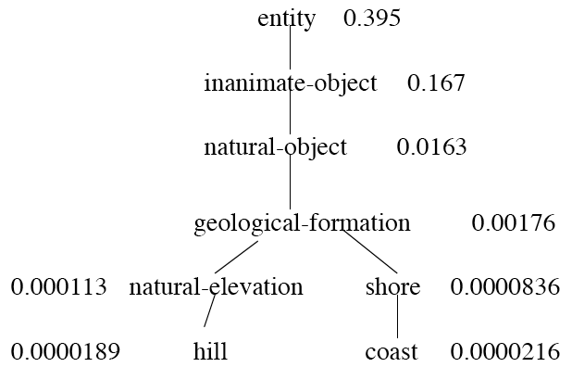
Information content similarity
WordNet hierarchy augmented with probabilities P(c)
D. Lin. 1998. An Information-Theoretic Definition of Similarity. ICML 1998

Slide 46
Information content and probability
The self-information of an event, also called its surprisal:
how surprised we are to know it; how much we learn by knowing it.
The more surprising something is, the more it tells us when it happens
We’ll measure self-information in bits.
I(w)= -log2 P(w)
I flip a coin; P(heads)= 0.5
How many bits of information do I learn by flipping it?
I(heads) = -log2(0.5) = -log2 (1/2) = log2 (2) = 1 bit
I flip a biased coin: P(heads )= 0.8 I don’t learn as much
I(heads) = -log2(0.8) = -log2(0.8) = .32 bits

Slide 47
Information content: definitions
1.3 bits
Information content:
IC(c) = -log P(c)
Most informative subsumer (Lowest common subsumer)
LCS(c₁,c₂) =
The most informative (lowest) node in the hierarchy subsuming both c₁ and c₂
5.9 bits
9.1 bits
15.7 bits

Slide 48
Using information content for similarity: the Resnik method
Philip Resnik. 1995. Using Information Content to Evaluate Semantic Similarity in a Taxonomy. IJCAI 1995.
Philip Resnik. 1999. Semantic Similarity in a Taxonomy: An Information-Based Measure and its Application to Problems of Ambiguity in Natural Language. JAIR 11, 95-130.
The similarity between two words is related to their common information
The more two words have in common, the more similar they are
Resnik: measure common information as:
The information content of the most informative
(lowest) subsumer (MIS/LCS) of the two nodes
sim_{resnik}(c₁,c₂) = -log P( LCS(c₁,c₂) )

Slide 49
Dekang Lin method
Dekang Lin. 1998. An Information-Theoretic Definition of Similarity. ICML
Intuition: Similarity between A and B is not just what they have in common
The more differences between A and B, the less similar they are:
Commonality: the more A and B have in common, the more similar they are
Difference: the more differences between A and B, the less similar
Commonality: IC(common(A,B))
Difference: IC(description(A,B)-IC(common(A,B))

Slide 50
Dekang Lin similarity theorem
The similarity between A and B is measured by the ratio between the amount of information needed to state the commonality of A and B and the information needed to fully describe what A and B are
Lin (altering Resnik) defines IC(common(A,B)) as 2 x information of the LCS

Slide 51
Lin similarity function

Slide 52
The (extended) Lesk Algorithm
A thesaurus-based measure that looks at glosses
Two concepts are similar if their glosses contain similar words
Drawing paper: paper that is specially prepared for use in drafting
Decal: the art of transferring designs from specially prepared paper to a wood or glass or metal surface
For each n-word phrase that’s in both glosses
Add a score of n²
Paper and specially prepared for 1 + 2² = 5
Compute overlap also for other relations
glosses of hypernyms and hyponyms

Slide 53
Summary: thesaurus-based similarity

Slide 54
Libraries for computing thesaurus-based similarity
NLTK
http://nltk.github.com/api/nltk.corpus.reader.html?highlight=similarity - nltk.corpus.reader.WordNetCorpusReader.res_similarity
WordNet::Similarity
http://wn-similarity.sourceforge.net/
Web-based interface:
http://marimba.d.umn.edu/cgi-bin/similarity/similarity.cgi

Slide 55
Evaluating similarity
Extrinsic (task-based, end-to-end) Evaluation:
Question Answering
Spell Checking
Essay grading
Intrinsic Evaluation:
Correlation between algorithm and human word similarity ratings
Wordsim353: 353 noun pairs rated 0-10. sim(plane,car)=5.77
Taking TOEFL multiple-choice vocabulary tests
Levied is closest in meaning to:
imposed, believed, requested, correlated

